Slide 1
Fundamental Programming in JAVA
Access Specifiers (Visibility Modifiers)

Slide 2
Objectives
To distinguish between instance and static variables and methods .
To define private data fields with appropriate, get and set methods .
To encapsulate data fields to make classes easy to maintain
To define the scope and visibility of the data fields and class members in the code
to restrict the levels of access to certain data, ensuring security by preventing unintended alterations.

Slide 3
Objectives
How to use this reference to Refer to a class’s hidden data fields
How to use this reference to enable a constructor to call another constructor of the same class
Method overloading ,passing &returning object and garbage collection concepts

Slide 4
Method Abstraction
You can think of the method body as a black box that contains the detailed implementation for the method.

Slide 5
Access Specifiers (Visibility Modifiers)
To prevent direct modifications of data fields, you should declare the fields (private). This is known as data field encapsulation.
To provide the client the ability to access and modify private data fields, (set and get) methods should be written to change and retrieve their values, respectively.
Why data fields should be private? To protect data and to make code easy to maintain.

Slide 6
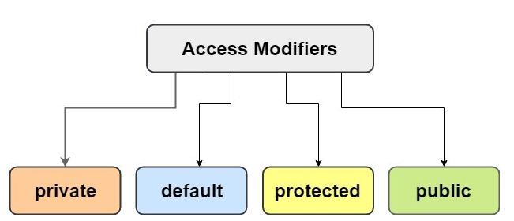
Access Specifiers (Visibility Modifiers)
Access Modifiers: are used to set the accessibility (visibility) and specify the scope of a class, constructor, variable, method, or data member.
There are four types of access modifiers available in Java:

Slide 7
Access Specifiers (Visibility Modifiers)
An access specifier is a Java keyword that indicates how a field or method can be accessed.
public
When the public access specifier is applied to a class member, the member can be accessed by code inside the class or outside.
Private
When the private access specifier is applied to a class member, the member cannot be accessed by code outside the class. The member can be accessed only by methods that are members of the same class.

Slide 8
Access Specifiers (Visibility Modifiers)
If public or private is not used, the specifier consider default.
When the default access specifier is applied to a class member, The member can be accessed by any class in the same package (package-private). The default modifier restricts access to within a package.
Protected
used with inheritance. (will be discussed later).

Slide 9
Accessor (getters) and Mutator (setters) Methods
Because of the concept of data hiding, fields in a class are private.
The methods that retrieve the data of fields are called accessors(setters).
The methods that modify the data of fields are called mutators(getters).
Each field that the programmer wishes to be viewed by other classes needs an accessor.
Each field that the programmer wishes to be modified by other classes needs a mutator.

Slide 10
Accessors and Mutators
Rectangle
Class name goes here
width : double
length : double
Fields are listed here
+ getters
+ setters
Accessors & Mutators

Slide 11
Accessors and Mutators
For the Rectangle example, the accessors and mutators are:
setLength: Sets the value of the length field.
public void setLength(double len) …
setWidth: Sets the value of the width field.
public void setLength(double w) …
getLength: Returns the value of the length field.
public double getLength() …
getWidth: Returns the value of the width field.
public double getWidth() …
Other names for these methods are getters and setters.

Slide 12
Setter & getter Methods
In view of the foregoing, private variables can only be accessed within the same class. However, it is possible to access them if we use public get and set methods.
Getter and Setter are methods used to protect your data and make your code more secure.
Getter and Setter make the programmer convenient in setting and getting the value for a particular data type.
The syntax for both is that they start with either get or set, followed by the name of the variable, with the first letter in an upper-case example: setName() and getName(), to change and retrieve the value of the name data field, respectively.

Slide 13
Getter method: syntax
The getter method starts with the word “get” followed by the variable name, getter method returns the value in different data types; int, String, double, float, etc.
Below is an example of the syntax of a getter method:
public returnType getPropertyName (){
return property;
}

Slide 14
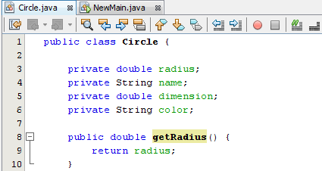
Getter method: Example
The getRadius() method returns the value of the variable name (radius).

Slide 15
Setter method: syntax
Setter method sets or updates the value of any given. It starts with the word “set” followed by the variable name.
Below is an example of the syntax of a setter method:
public void setPropertyName (dataType newPropertValue){
this.property = newPropertValue;
}

Slide 16
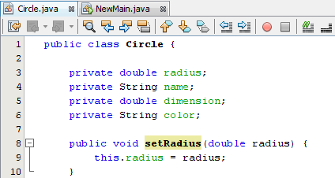
Setter method: Example
The setRadius(dataType newValue) method receives the parameter (new radius value) and assigns it to the variable (radius), this keyword is used to refer to the current object.
The other purpose of the set methods is to check the validity of the data fields values.

Slide 17
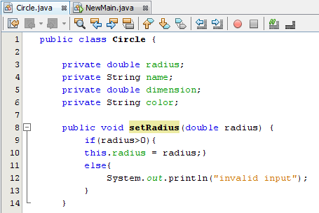
Setter method: Validation Example
In the example before, the values of the radius can’t be negative. This condition is checked in the set method, which should be invoked using the constructors to ensure that the data fields are valid even during the creation of objects.

Slide 18
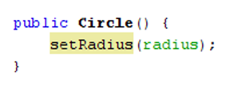
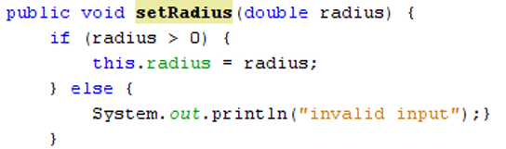
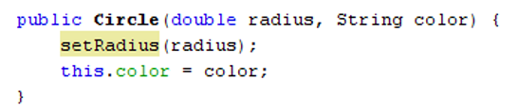
Setter method: Validation Example

Slide 19
Cont. Setter method: Validation Example
Note! Remember: The set method that is checking the validity of the data fields should be invoked through the constructors to make sure that the data fields are valid even during the creation of objects.

Slide 20
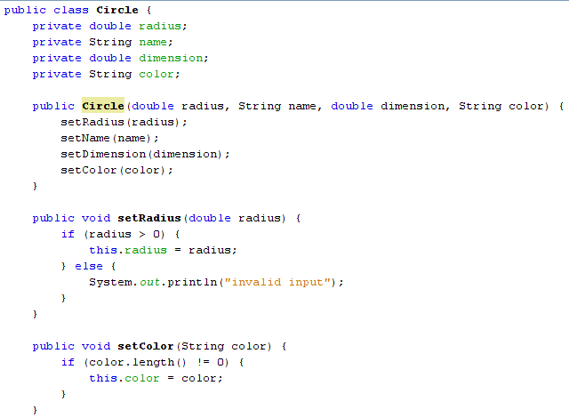
Getter & Setter methods: Example

Slide 21
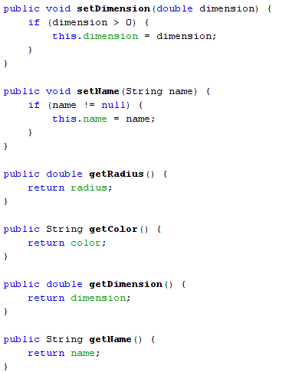
Cont. Getter & Setter methods: Example

Slide 22
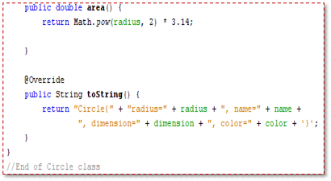
Cont. Getter & Setter methods: Example

Slide 23
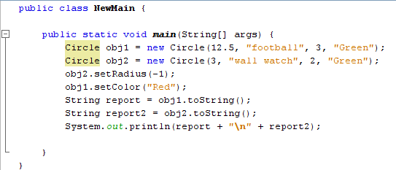
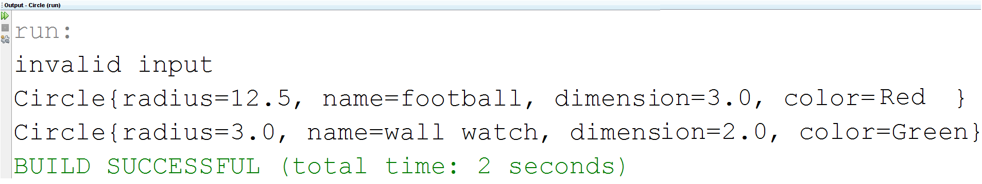
Getter & Setter method: (Main Class)

Slide 24
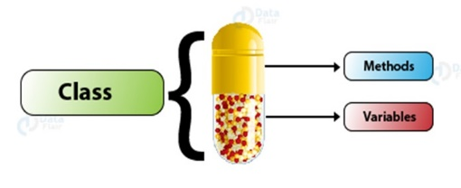

Encapsulation
Encapsulation: is defined as binding together the data and the methods that manipulate them.

Slide 25
Data Hiding
An object hides its internal, private fields from code that is outside the class that the object is an instance of.
Only the class's methods may directly access and make changes to the object’s internal data.
Code outside the class must use the class's public methods to operate on an object's private fields.
Data hiding is important because classes are typically used as components in large software systems, involving a team of programmers.
Data hiding helps enforce the integrity of an object's internal data.

Slide 26
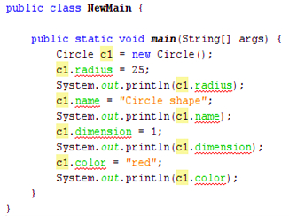
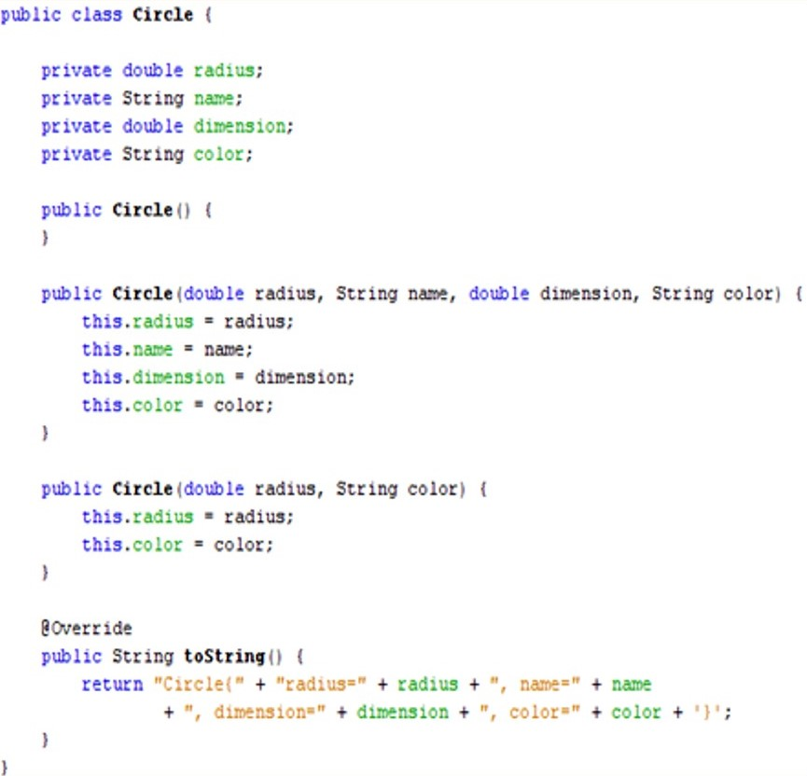
Data fields Encapsulation (Attributes & Constructors)
Circle class has private data members. In the NewMain class, we are going to access these private members from outside the class. Hence, there are compile-time errors Why?)

Slide 27
Data fields Encapsulation
The cause of the compile-time errors in the previous example from line 6 to 13 in the class (NewMain) that, the radius, name dimension, and color are defined private and cannot be accessed from outside the Circle class.
To access and modify these private data fields, the (setter and getter) methods should be used to change and retrieve their values.

Slide 28
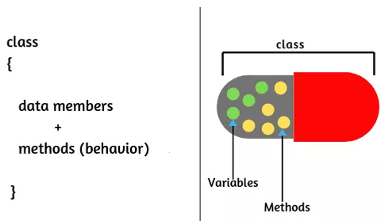
Why Encapsulation?
Better control of class attributes and methods.
Class attributes can be only read-only (if you only use the get method) or write-only (if you only use the set method).
Flexibility: the programmer can change one part of the code without affecting other parts.
Increased security of data.

Slide 29
Exercises
Write a Java program to create a class called Person with private instance variables name, age. and country. Provide public getter and setter methods to access and modify these variables.
Write a Java program to create a class called BankAccount with private instance variables accountNumber and balance. Provide public getter and setter methods to access and modify these variables.

Slide 30
Exercises
Write a Java program to create a class called Car with the following class members:
private instance variables company_name , model_name of type String , year, and mileage of type integer.
Provide public getter and setter methods to access and modify the variables.
The value of year can't be greater than current year.
The model name can't be empty String.
three different constructors.

Slide 31
Static Method
static method: a method that belongs to a class, not a specific object.
A static method can be invoked without the need for creating an instance of a class .

Slide 32
Static Method
Static methods (class methods) are not tied to a specific object.
A static method can be invoked without the need for creating an instance of a class.
A static method can access static data member and can change the value of it.
The static method can not use non static data member or call non-static method directly.
They are typically used to create utility classes, such as the Math class in the Java Standard Library.
this and super cannot be used in static context (explained later).

Slide 33
Static Method
Examples of static methods in java:
All the methods defined in the Math class are static methods ex: Math.sqrt().
main() System.out.println()
public class MyClass {
public static void main(String[] args) {
double num, root;
…
root = Math.sqrt(num);
System.out.println("Root is " + root);
} …

Slide 34
Static Variables, Constants, and Methods
To declare static variables, constants, and methods, use the static modifier.
Static constants are final variables shared by all the instances of the class.
Static variables (class variables) are shared by all the instances of the class.
The static variable gets memory only once in the class area at the time of class loading.
Static data m.embers of class exist even when no object of class type is instantiated

Slide 35
Static Variables
private static int instanceCount = 0;
The field is initialized to 0 only once, regardless of the number of times the class is instantiated.
Primitive static fields are initialized to 0 if no initialization is performed.
instanceCount field
(static)
3
Object1
Object2
Object3

Slide 36
Static Data Field
The static keyword is a non-access modifier used for attributes, which makes their values the same for all the objects; i.e., when we declare a field static, exactly a single copy of that field is created and shared among all instances of that class.
The static keyword is mainly used for memory management.
The value of the (static) field can be changed like any other data fields.

Slide 37
Static Data Field
The method that returns the (static) field should be defined as (static) as well.
The method that Modify the (static) field should be defined as (static) as well.
Since the value (static) field is the same for all the objects, you can invoke the (get) method that returns the value of the (static) field either via an object name or via the class name itself.

Slide 38
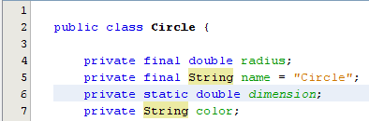
Static Data Field: Explanation
In the above example, we want to make the value of dimension data field is the same for all the objects. So, as shown in line 6 of a class circle, we add a static keyword for the dimension data members.

Slide 39
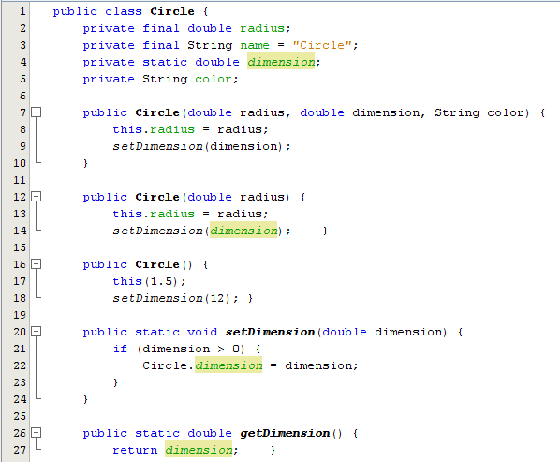
Static Data Field: at object level Explanation
Remember:
The method that returns or Modify the (static) field should be defined as (static) as well

Slide 40
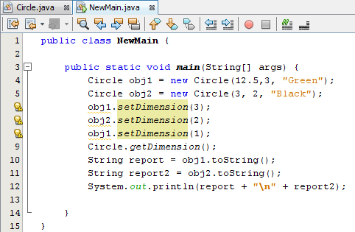
Static Data Field: Main
obj1
obj2
radius: 12.5
name: circle
Color: Green
radius: 3
name: circle
Color: Black
Shares
Shares
Static variable (dimension):
3
2
3
2
1
The value of (1) is the last value that will be stored in the memory for the variable (dimension).

Slide 41
Static Data Field: Main
Since the value (static) field is the same for all the objects, you can invoke the (get or set) method that returns or modify the value of the (static) field either via an object name or via the class name itself.

Slide 42
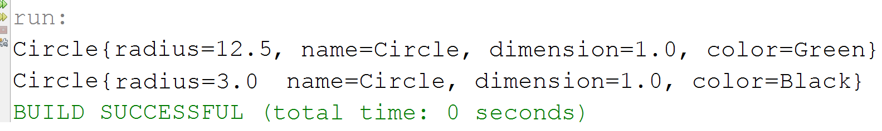
Static Data Field: Main
Output:

Slide 43
Method Overloading
Method overloading: More than one method can have the same name.
Two methods are said to have different formal parameter lists:
If both methods have a different number of formal parameters.
If the number of formal parameters is the same in both methods, the data type of the formal parameters in the order you list must differ in at least one position.

Slide 44
Method Overloading, cont.
public void methodOne(int x)
public void methodTwo(int x, double y)
public void methodThree(double y, int x)
public int methodFour(char ch, int x, double y)
public int methodFive(char ch, int x, String name)
These methods all have different formal parameter lists.

Slide 45
Method Overloading, cont.
public void methodSix(int x, double y, char ch)
public void methodSeven(int one, double u, char firstCh)
The methods methodSix and methodSeven both have three formal parameters, and the data type of the corresponding parameters is the same.
These methods all have the same formal parameter lists.

Slide 46
Method Overloading, cont.
Method overloading: Creating several methods within a class with the same name.
The signature of a method consists of the method name and its formal parameter list. Two methods have different signatures if they have either different names or different formal parameter lists. (Note that the signature of a method does not include the return type of the method.)

Slide 47
Method Overloading, cont.
The following method headings correctly overload the method methodXYZ:
public void methodXYZ()
public void methodXYZ(int x, double y)
public void methodXYZ(double one, int y)
public void methodXYZ(int x, double y, char ch)

Slide 48
Method Overloading, cont.
The following method headings correctly overload the method add():
public int add(int num1, int num2) {
int sum = num1 + num2;
return sum; }
public String add (String str1, String str2) {
String combined = str1 + str2;
return combined; }

Slide 49
Method Overloading, cont.
public void methodABC(int x, double y)
public int methodABC(int x, double y)
Both these method headings have the same name and same formal parameter list.
These method headings to overload the method methodABC are incorrect.
In this case, the compiler will generate a syntax error. (Notice that the return types of these method headings are different.)

Slide 50
Ambiguous Invocation
Sometimes there may be two or more possible matches for an invocation of a method, but the compiler cannot determine the most specific match. This is referred to as ambiguous invocation.
Ambiguous invocation is a compile error.

Slide 51
Ambiguous Invocation, cont.
public class AmbiguousOverloading {
public static void main(String[] args) {
System.out.println(max(1, 2)); }
public static double max(int num1, double num2) {
if (num1 > num2)
return num1;
else
return num2; }
public static double max(double num1, int num2) {
if (num1 > num2)
return num1;
else
return num2;
}
}

Slide 52
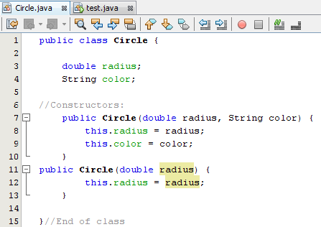
The (this) reference
The (this) keyword is the name of a reference that reference to a calling object itself. There are several uses of this operator:
Reference a class’s hidden data fields: Example:

Slide 53
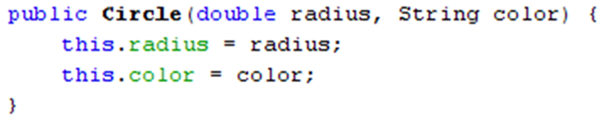
The (this) reference: Explanation
In this case, the parameters of the (Circle) Constructor have the same name as the data fields (radius, and color). To distinguish between the parameter name (radius, and color) and the data field (radius, and color), the (this) operator should be used to access the data field.
But if the parameters of the (Circle) Constructor have the same name as the data fields (radius, and color) and (this) operator is not used, then in this case it will be dealt with (data field (radius, and color)) as local variable.

Slide 54
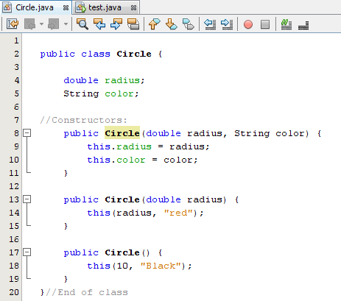
The (this) reference:
Enable a constructor to call another constructor of the same class: Example:

Slide 55
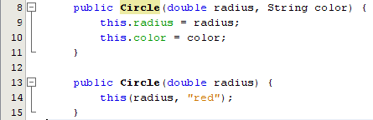
The (this) reference:
In the above example, line 14 invokes the constructor with 2 parameters which is in line 8 to set the data fields values as passed from line 14 (i.e., the value of (radius), red)

Slide 56
Passing Objects as Arguments
Objects can be passed to methods as arguments.
Java passes all arguments by value.
When an object is passed as an argument, the value of the reference variable is passed.
The value of the reference variable is an address or reference to the object in memory.
A copy of the object is not passed, just a pointer (a reference) to the object.
When a method receives a reference variable as an argument, it is possible for the method to modify the contents of the object referenced by the variable.

Slide 57
Passing Objects as Arguments
A Rectangle object
length:
width:
12.0
5.0
displayRectangle(box);
Address
public static void displayRectangle(Rectangle r)
{
// Display the length and width.
System.out.println("Length: " + r.getLength() +
" Width: " + r.getWidth());
}

Slide 58
Returning Objects From Methods
Methods are not limited to returning the primitive data types.
Methods can return references to objects as well.
Just as with passing arguments, a copy of the object is not returned, only its address.
Method return type:
public static BankAccount getAccount(){
…
return new BankAccount(balance);}

Slide 59
Returning Objects From Methods
account = getAccount();
A BankAccount Object
balance:
3200.0
address
public static BankAccount getAccount()
{
…
return new BankAccount(balance);
}

Slide 60
Using null Reference
A null reference is a reference variable that points to nothing.
A special null value may be assigned to an object reference, but not to a primitive.
You can compare object references to null.
You can remove the association to an object by setting the object reference to null.
Car c1; //Declare object reference
…
if (c1 == null) //Ref not initialized?
c1 = new Car(); //Create a Car object
…
c1 = null; //Forget the Car object

Slide 61
Garbage Collection
As shown in the following figure, after the assignment statement c1 = c2, c1 points to the same object referenced by c2. The object previously referenced by c1 is no longer referenced. This object is known as garbage. Garbage is automatically collected by JVM.

Slide 62
The toString Method
All objects have a toString method that returns the class name and a hash of the memory address of the object.
We can override the default method with our own to print out more useful information
Overriding is one of the OOP concepts and will be discussed later in details.
public String toString() {
return “Rectangle{" + " Length: = " + Length
+ ", Width: = " + Width “}”;
}

Slide 63
The toString Method
The toString method of a class can be called explicitly:
Rectangle box = new Rectangle(10.5, 9.62);
System.out.println(box.toString());
However, the toString method does not have to be called explicitly but is called implicitly whenever you pass an object of the class to println or print.
Rectangle box = new Rectangle(10.5, 9.62);
System.out.println(box);

Slide 64
The toString Method
The toString method is also called implicitly whenever you concatenate an object of the class with a string.
Rectangle box = new Rectangle(10.5, 9.62);
System.out.println("The box data is:\n" + box);

Slide 65
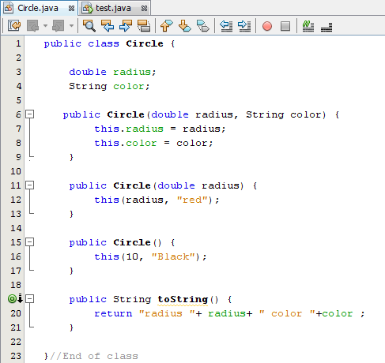
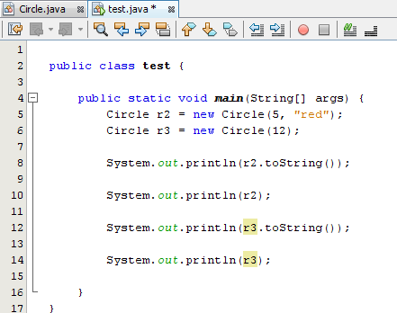
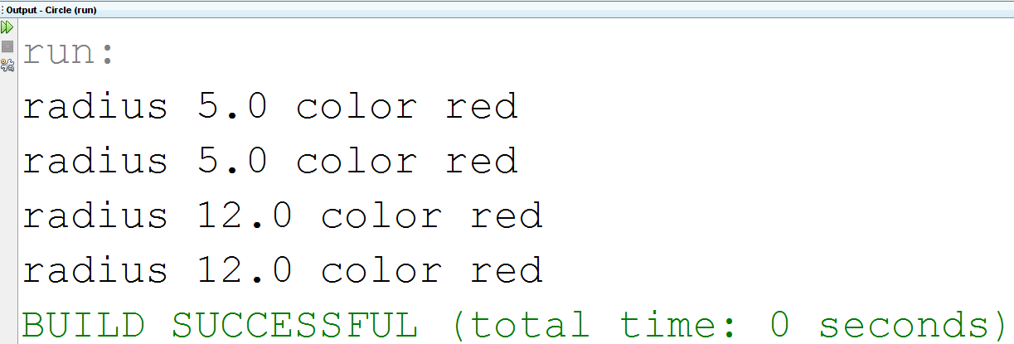
(toString) method
Output:

Slide 66
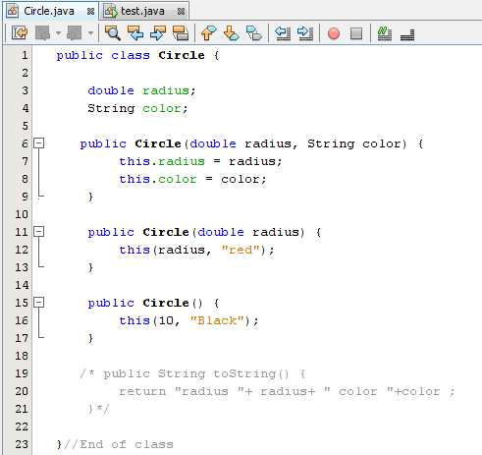
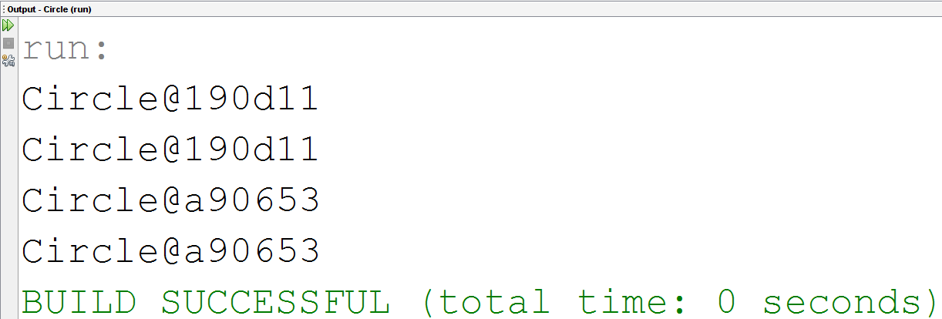
(toString) method
Notice that the toString method is disabled in this example
Output:

Slide 67
References
[1] Introduction to Java Programming, Comprehensive Version, Student Value Edition, Daniel Liang, 12th Edition, Pearson 2019
lecture Notes :edugate.asu.edu.jo.
lecture Videos : YouTube channel.
Lab manual ???

